Slide 1
علائم رادیوگرافیک شکستگی اندامها
مرکز آموزشی درمانی شهدا تبریز
دکتر علیرضا صادقپور
تیر ماه 1399
Notes:
In this unit we will be discussing fractures.

Slide 2
قسمتهای مختلف استخوان
اپی فیز
صفحه رشد
متافیز
دیافیز
Notes:
I would like to review the various terms utilized in describing the various parts of long bones. The epiphysis represents the bony portion directly adjacent to the articular surface to which the articular surface is attached to and adjacent to the joint. The physis or epiphyseal plate represents a cartilaginous portion that exists during the developmental phases between the epiphysis and the adjoining metaphysis or the area typically broadened at the junction of the shaft of the long bone with the epiphysis. The shaft or central portion of the long bone referred to as the diaphysis.

Slide 3
انواع شکستگیها
طولی
عرضی
مایل
مارپیچی
ناکامل
شکل T
شکستگی بهم فشرده
چند تکه ای
پاتولوژیک
شکستگی بسته
شکستگی باز
کندگی استخوانی
Notes:
I would next like to talk a little bit about a fracture classification or description scheme that is commonly used in radiology in order to identify and described fractures in such a fashion that a referring physician would understand the findings. A longitudinal fracture represents a fracture parallel to the long axis of the bone. That is contrasted by the transverse fracture, a fracture that is perpendicular to the long axis the bone or across the bone. An oblique fracture is a fracture that travels on a diagonal across the long axis of the bone. A spiral fracture is a fracture that wraps around the bone so that the medial and lateral or anterior and posterior crossings of the bone are at different levels. An incomplete fracture is just that, a fracture the does not completely involve the cortex. A “T” type fracture is a fracture that includes both longitudinal and transverse components. An impacted or compressed fracture is where the trabecular structure of the bone has been pushed together by a direct trauma along the long axis of the bone leading to compression. A comminuted fracture speaks to a fracture that has multiple components to it, so multiple small pieces. A pathologic fracture is a fracture through a preexisting condition of the bone, whether this preexisting condition be of a benign or malignant nature. Closed fractures, in the past referred to as simple fractures are fractures that did not penetrate the skin surface. An open fracture represents a fracture where there is penetration of the bone through the skin surface. In the past these have been referred to as compound fractures. And finally, an avulsion fracture is a fracture that takes place at a point of tendon insertion or ligamentous attachment to bone, where a portion of the adjoining bone is pulled away.

Slide 4
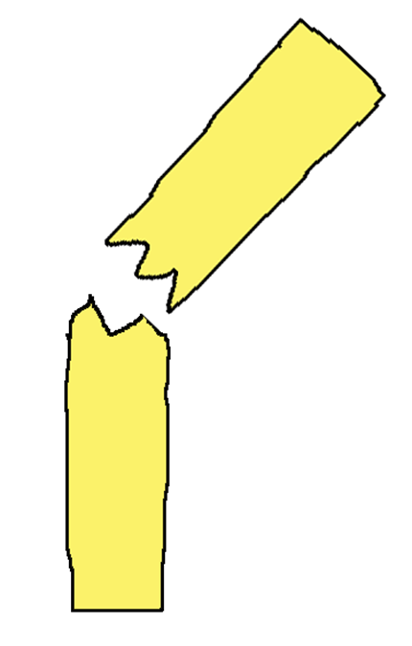
وضعیت قطعات شکستگی
جابجایی
زاویه دار شدن
کوتاهی
چرخش
شکستگی دررفتگی
Notes:
Fractures are described differently at institution, but appear most often to be described consistently at any one particular institution. My practice is to describe fractures by describing the relationship of the distal portion of the fracture to the more proximal aspect. In discussion of fractures we need to speak of displacement, displacement of the proximal distal portions; any angulation that may take place at the fracture site; any evidence for shortening of the bones, shortening typically caused by overlapping; any rotation of the bony fragments, this is especially important when we think about it, because you could have no displacement but you could have 90° rotation which could have a significant impact; and we also talk about any abnormalities of the joint that might be involved, such as a loss of continuity at a joint, which is referred to as a dislocation; subluxation may occur at a joint with or without fracture, and this is a result of partial loss of continuity at that joint; and finally fracture dislocations will be described, and that is when a bone has a fracture and there is an associated dislocation at the adjoining joint.

Slide 5
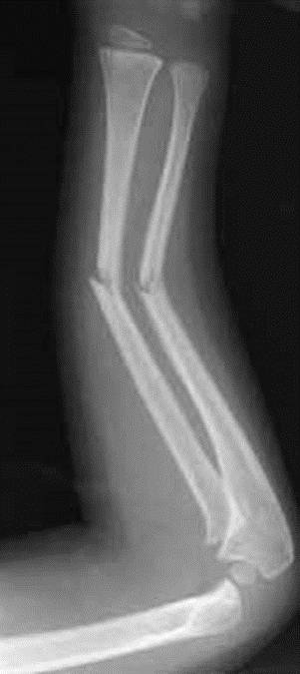

Slide 6
ارزیابی های تشخیصی
رادیوگرافی ساده ( حداقل در دو نمای رخ و نیمرخ )
دیده شدن تمام طول استخوان و دو مفصل مجاور
Notes:
Additionally in fracture evaluation, x-ray films should always be taken in at least two projections and typically these are if at all possible perpendicular to each other, for instance, an AP and a lateral view. Additionally, these x-ray films should be large enough to include at least the adjoining joint and adjoining soft tissues of the area of injury. At times it is important to include both proximal and distal joints, especially when evaluating fractures involving paired bone such as the forearm and lower leg.

Slide 7
در کودکان ممکن است برای تشخیص دقیق تر رادیوگرافی از طرف سالم نیز لازم شود.
Notes:
In a child occasionally the healthy opposite side will be included to provide a comparison for the various growth plates and growth centers that exist in the child. To answer special question some special studies might also be included. Among those might be oblique views, stress films where the orthopedic or emergency physician may stress a joint to allow more careful evaluation of possible ligamentous injury, flexion and extension views especially when speaking about the spine, and perhaps films that are delayed after a period of several days or a week to allow early bony remodeling or early repair to take place to make the fracture line more conspicuous.

Slide 8
شکستگی دوبل ساق پا
شکستگی مارپیچی تیبیا و چند تکه ای فیبولا
نمای روبرو
Notes:
Let us try to apply some of our newly learned terms and ideas to a patient. Here is a lower leg projection of an individual experiencing trauma. In this frontal projection note the oblique fracture of the distal portions of the tibia. This could be described as having angulation with its convexity directed towards the lateral aspect of the lower leg at the fracture site. There is slight medial displacement of the distal fragment with respect to the more proximal fragment and this fracture is accompanied by a comminuted fracture of the proximal portion of the fibula. There is some lateral displacement of the distal portion of the fibula with respect to the proximal fragment. There is angulation present. The convexity is directed laterally at the fracture.

Slide 9
نمای لترال
نمای ناکافی( شکستگی فیبولا بطور کامل دیده نمیشود – مفصل زانو و مچ پا دیده نمیشود )
Notes:
In this same individual, the lateral view is also helpful because it gives us information about what is happening in the perpendicular direction. We note posterior displacement of the tibial fracture and we also note that this fracture is somewhat spiral in its nature. Also, we see slight angulation convex anteriorly at the fracture site. This study or this film is inadequate because we really do not identify the fibular fracture on this particular collection of images.

Slide 10
شکستگی چند تکه ای پلاتوی تی بیا

Slide 11
شکستگی بای مالئولار مچ پا

Slide 12
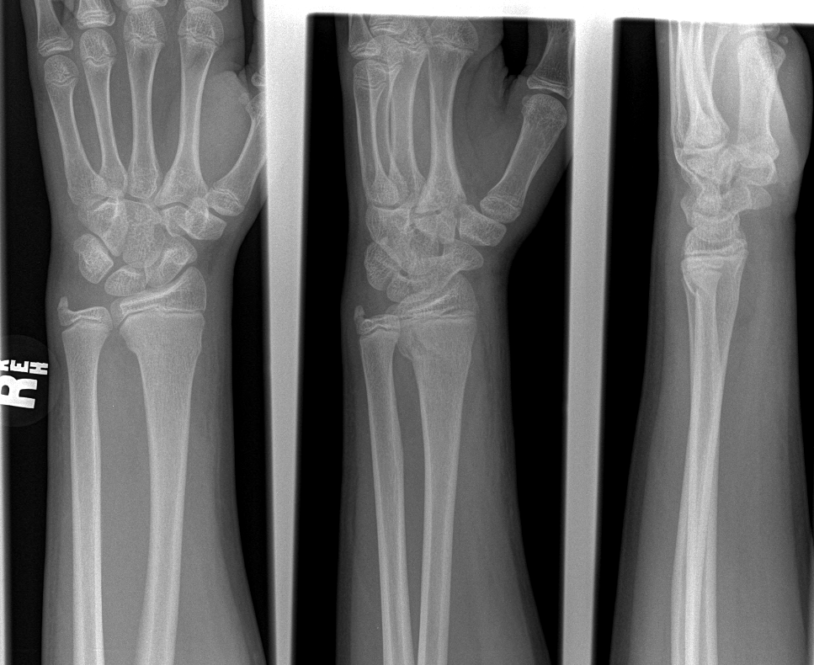
شکستگی دیستال ساعد
شکستگی بهم فشرده رادیوس و کندگی استیلوئید اولنا
Notes:
Let us look another patient. Here is a forearm injury. Note that this fracture of the distal radius does not have any angulation. Have you identified the small irregularity of the medial and lateral cortex of the distal radius in this individual? This is a transverse slightly impacted fracture of the radius sometimes referred to as a torus fracture. We will talk a little bit more about torus fractures when we discuss pediatric type injuries. There is an associated ulnar fracture involving the ulnar styloid. Paired bones frequently, in fact, very commonly will have associated fractures.

Slide 13
شکستگی T شکل
Notes:
Here is another wrist in another individual. In this case we see a fracture involving the distal radius that also has a vertical component which is somewhat lucent as seen on the black and yellow arrows. The horizontal component demonstrates slight impaction with a sclerotic line being noted across the distal radius as indicated by the yellow arrow. This type of fracture is common in an older adult who falls on the outstretched arm.

Slide 14
شکستگی بهم فشرده رادیوس
Notes:
In another older individual we again identify an impacted fracture involving the distal radius. Notice the sclerotic band across the distal radius about where we would expect to see the epiphyseal plate on a younger individual. This is indicated by the yellow arrow. This represents an impaction fracture.

Slide 15
شکستگی مایل تی بیا
Notes:
In this individual we have included the frontal and lateral projection of a tibial fracture. Note the oblique almost spiral fracture involving the midshaft of the tibia. This is barely visible on the frontal examination thus the importance of including both frontal and perpendicular imaging

Slide 16
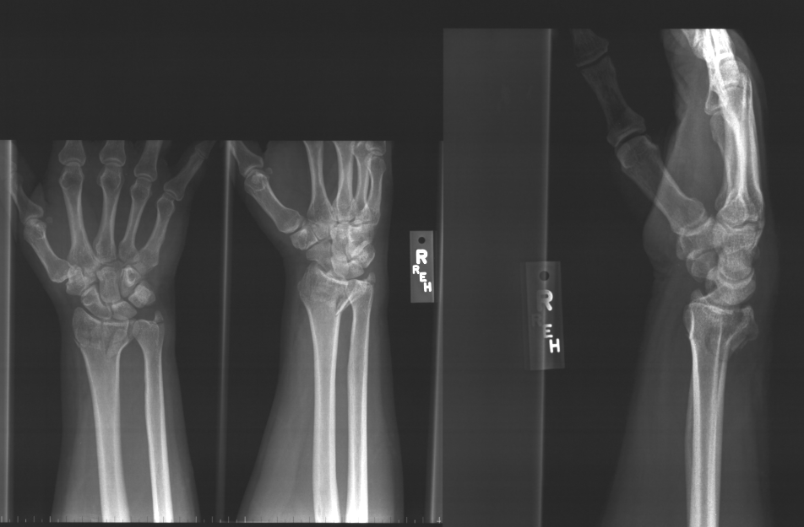
شکستگی داخل مفصلی دیستال رادیوس همراه با خرد شدگی
Notes:
Another wrist, this time with a fracture at the distal radius that has multiple components, this being a comminuted fracture of the distal radius. There is slight anterior angulation of this fracture. There is extension of this fracture into the joint space. This fracture is also somewhat comminuted. This is the fracture sometimes referred to as a Colles fracture.

Slide 17
شکستگی بدون جابجائی اسکافوئید
Notes:
An important fracture to identify following injury to the wrist is a fracture involving the scaphoid bone. These at times can be very difficult to define. In this particular case there is an undisplaced fracture that is only identified as a very subtle lucent line extending through the midportion of the scaphoid as indicated by the yellow arrow.

Slide 18
شکستگی قدیمی اسکافوئید
*
*
Notes:
In another individual the scaphoid fracture is much easier to see as indicated by the white and black arrows. In this case there has been a disruption of the normal blood supply to the scaphoid which proceeds from distal to proximal. As a result of this disruption at the asterisk I have indicated the sclerosis that is seen of the proximal fragment, this as a result of loss of the normal blood supply and aseptic necrosis of this proximal portion.

Slide 19
نکروز آواسکولار AVN
*
Notes:
The magnification view of the same patient more clearly defines the fact that this fracture line is related to an old injury as it has a smooth somewhat undulant cortex developed along the fracture line as a result of the chronic nature, and as I mentioned a moment ago the sclerosis of the proximal portion caused by loss of blood supply to this region. This avascular necrosis leads to considerable pain and arthritis thus the need to identify these early on to lower appropriate treatment.

Slide 20
Radial Head Fracture
Small joint effusion with small anterior and posterior fat pads
Minimally depressed radial head fracture
Notes:
In another individual an abnormality involving the radial head is identified. But first note the presence a small joint effusion with the presence of a small anterior and posterior fat pad. Normally at the elbow we may see occasionally an anterior fat pad. However, the presence of a fat pad posterior to the elbow is definitive evidence for the presence of a joint effusion. Which is most often associated with an accompanying fracture. In this case, a minimally depressed radial head fracture. This type of fracture, a radial head fracture would be one of the most common fractures of the elbow of an adult. Fractures in children as we will discuss in a different section are more commonly seen involving the distal portion of the humerus at the elbow following a fall on the outstretched arm.

Slide 21
شکستگی پاتولوژیک اسکافوئید
Notes:
Here is an example of a pathologic fracture. In this case, a developmental cyst present within the neck of the scaphoid has led to a weakness in this area and a subsequent fracture. The fracture through the cyst described as a pathologic fracture.

Slide 22
شکستگی سالتر هاریس تیپ 1
Notes:
On this example involving a child, we see another fracture, in this case an epiphyseal plate fracture with this dislocation fragment. This is a Salter-Harris 1 fracture. We will talk more about the Salter-Harris fractures in the pediatric section. Needless to say, as I mentioned, posterolateral displacement of the epiphysis with respect to the proximal portions of the radius, as indicated by the arrows.

Slide 23
شکستگی پروکزیمال هومروس چند تکه ای
Notes:
Here is an individual experiencing shoulder trauma with a fracture at the shoulder involving the surgical neck of the shoulder. The surgical neck being that portion of the shoulder or humerus just distal to the articular surface. The anatomic neck would actually transverse through the ball portion of the humerus more directly. This particular fracture in this individual is somewhat comminuted with several components being identified.

Slide 24
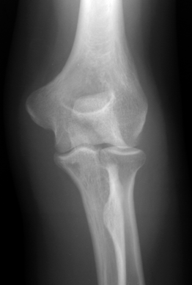
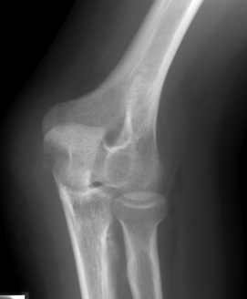
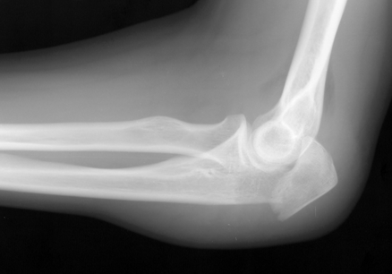
شکستگی اوله کرانون
Notes:
In another individual we note the presence of a fat pad and we also note the presence of a displaced fracture involving the proximal portion of the olecranon as indicated by the yellow arrow. Note also considerable soft tissue swelling about the dorsal surface of the elbow.

Slide 25
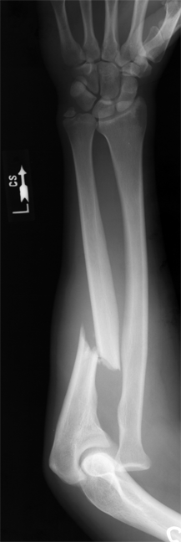
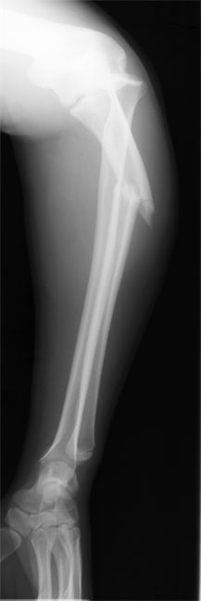
شکستگی دررفتگی مونته جیا
Notes:
This individual had the unfortunate circumstance of being injured as a result of direct trauma to the forearm, perhaps involved in an altercation…this sometimes referred to as a “night stick fracture”. In this case, a transverse displaced and angulated fracture of the ulna and an associated radial dislocation proximally. Remember that in paired bones, if one is involved the other is almost always involved as well.

Slide 26
شکستگی استرس تنه تی بیا
محل های شایع ( فمور – تیبیا – متاتارسها )
رادیوگرافی ساده اکثرا نرمال است
بون اسکن یا ام آر آی لازم میشود
Notes:
Stress injury is a type of injury that can occur in many different locations including the femur, tibia, metatarsals as well as other locations. Any change in normal activity can ultimately lead to a stress injury. In this case, bone scanning and MRI imaging can be useful to identify the site of bone injury prior to an actual abnormality being identified on the radiograph. In this particular individual the plain film is not negatives as it is in many cases. We here in this exam see a linear fracture with some callus in the distal anterior shaft of the tibia as indicated by the arrow on the enlarged image.

Slide 27
در حال ترمیم

Slide 28
شکستگی گردن فمور
Notes:
In another individual with an indication of a traumatic slip and fall what we identify here as a result of this recent fall is a disruption of the femoral neck. On the frontal study we can actually see an overlying edge and when we compare the left to right on the frontal pelvic examination we note the unusual foreshortening of the right femoral neck as a result of this fracture.

Slide 29
شکستگی دررفتگی مفصل ران
Notes:
Injuries of this type are typically as a result of the knee running into the dashboard in some type of an automobile deceleration injury. In this case the posterior wall of the acetabulum has been fractured with a posterior displacement of a portion of the acetabular margin and a dislocation of the femoral head both superiorly, laterally and posteriorly. The dislocated head being noted at the arrow, the source of the avulsed fragment at the second arrow, and finally the avulsed fragment setting above the acetabulum on the third arrow.

Slide 30
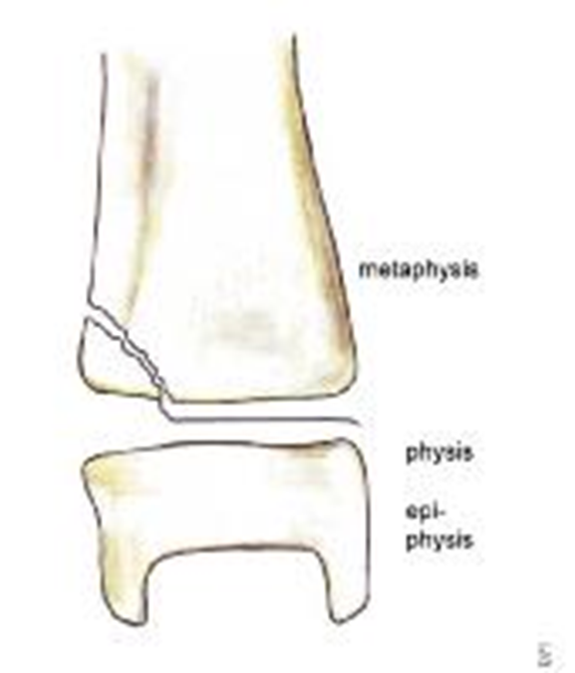
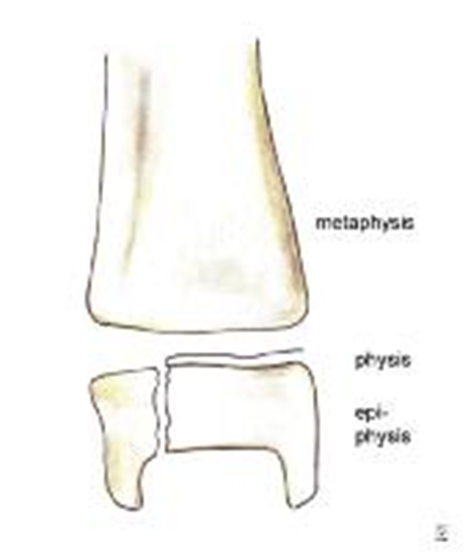
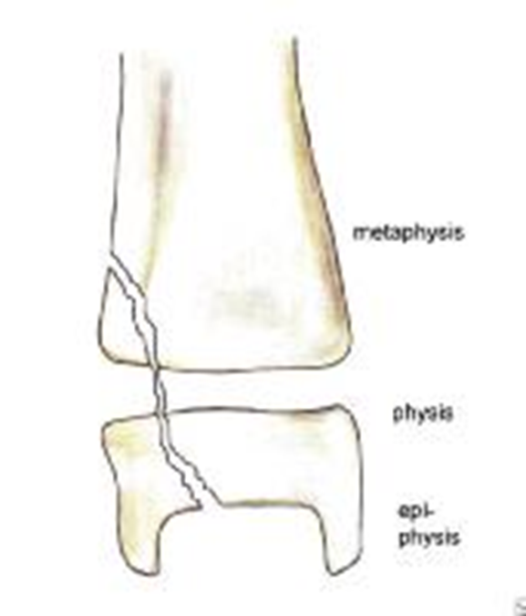
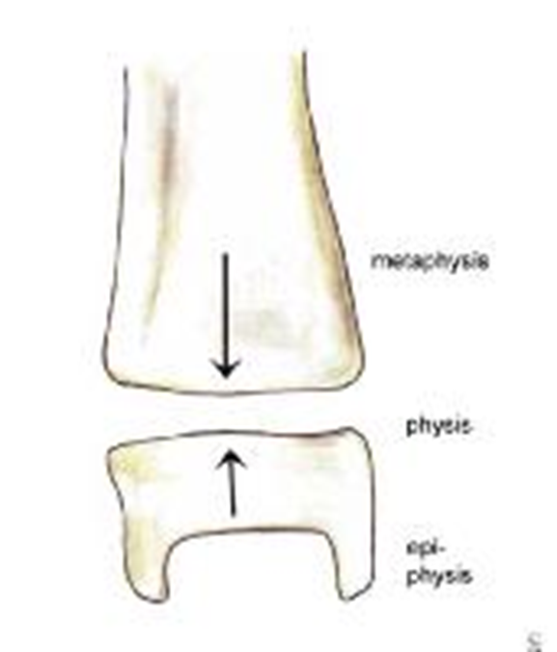
شکستگیهای صفحه رشد

Slide 31
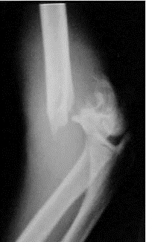
شکستگی باز تیپ 1

Slide 32
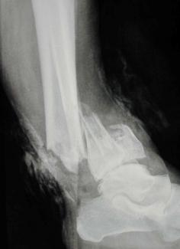
شکستگی باز تیپ 2

Slide 33
شکستگی باز تیپ III A

Slide 34
شکستگی باز III B

Slide 35
شکستگی باز III C

